Slide 1

Modern Education Society’s Wadia College of Engineering Pune
ADDRESSING THE ISSUES OF AI GENERATED FAKE IMAGES
Name: Yash Raosaheb Jadhav
PRN.NO:F21111013
Class: TE Comp 1
Guided by: Prof .S.D.Wagh

Slide 2
Seminar Topic name:
ADDRESSING THE ISSUES OF AI GENERATED FAKE IMAGES
Securing the Digital Realm: Countering Threats from AI-Generated Fake Images
Page 02 of 15

Slide 3

Introduction:
Deepfake is related to the generation of fake photographs or videos consisting of face of a specific person which gets replaced with another person face utilizing convolutional neural networks especially Generative Adversarial Networks (GAN).
Recent social media controversies involving celebrities' faces being replaced in pornographic movies are a huge disgrace to one's character and create permanent harm to famous and even ordinary people’s identities that demand methods to detect Deepfake.
In addition to that, it is a great danger to the security of biometric information and rises to other counterfeiting and fraudulent activities . Many faces swapping software Face2Face[3], mobile Apps like Snapchat pre-trained generative adversarial networks can very easily implement DeepFake.
Page 04 of 15

Slide 4
LITERATURE SURVEY

Slide 5
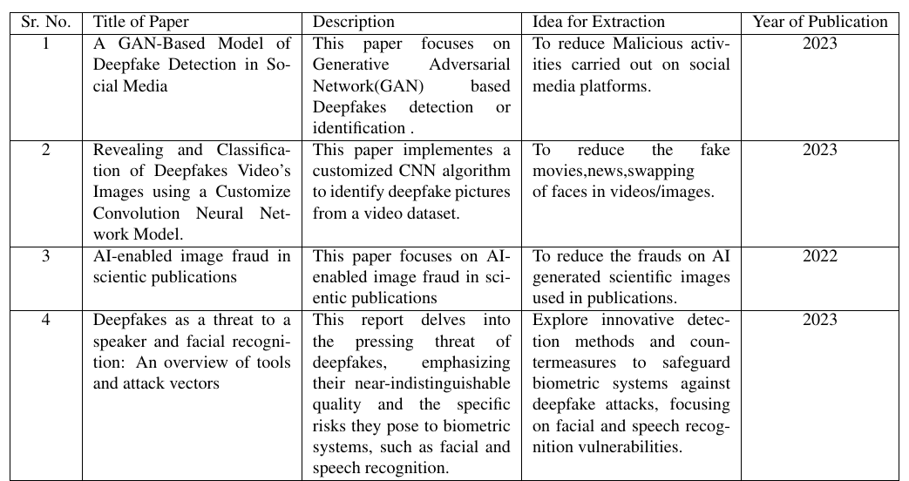
www.reallygreatsite.com
Page 06 of 15

Slide 6
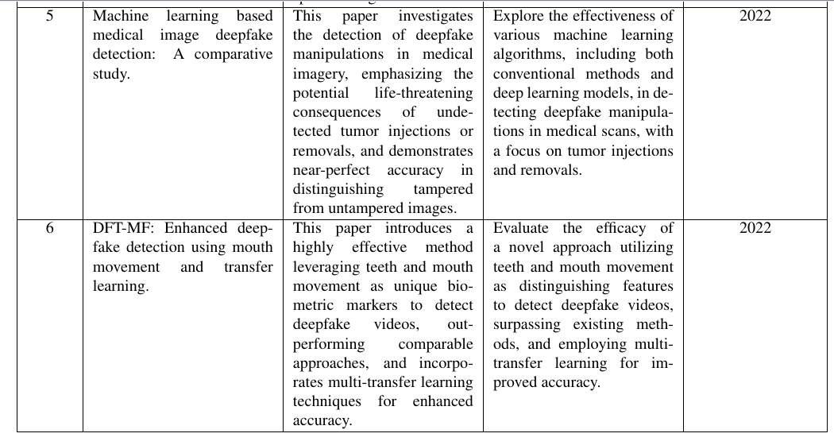
Page 08 of 15

Slide 7
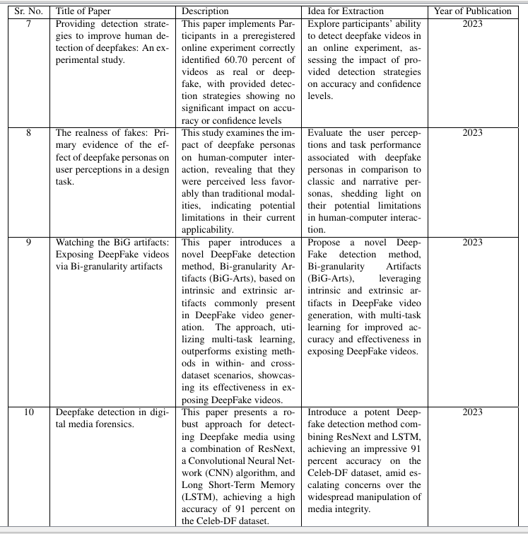
Page 06 of 15

Slide 8
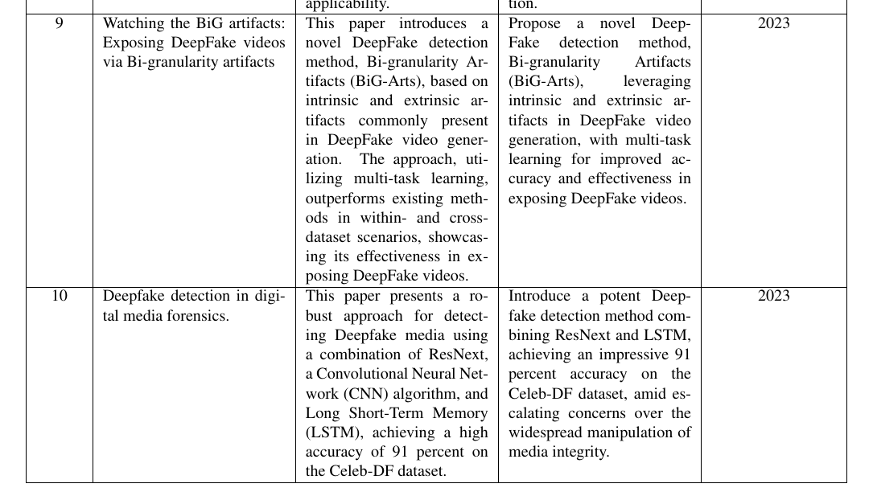
Page 06 of 15

Slide 9
MOTIVATION:
Emergence of Deepfake Technology: The rapid advancement of deepfake technology has led to the creation of highly convincing synthetic media.
Threat to Trust and Authenticity: Deepfake content can erode trust in digital media.
Protecting Privacy and Dignity: Deepfakes can be used to create non-consensual and potentially harmful content, including the creation of explicit or defamatory material involving individuals who never consented to such usage. Impressive Accuracy: Achieving 92.5% discrimination accuracy with low false positives.
Page 03 of 15

Slide 10
MOTIVATION:
Preserving Digital Forensics Integrity: In legal contexts, it is crucial to ensure that digital evidence, such as images or videos, maintains its integrity.
Empowering Content Creators and Platforms: Providing tools to identify and authenticate content helps content creators, social media platforms, and other digital services to maintain the integrity of their platforms.
Page 03 of 15

Slide 11
METHODOLOGY
www.reallygreatsite.com
Page 06 of 15

Slide 12
Architecture of GAN:
DC GAN Architectural Framework:
Specialized form of Generative Adversarial Network for image synthesis.
Incorporates convolutional layers without max-pooling operations.
Omits fully connected layers except at input and output stages.
Utilizes batch normalization for training stability.
Applies Leaky ReLU activation in the discriminator and tanh activation in the generator.
Input and Output:
Input is a 100-dimensional latent vector 'z'.
Generates a 64x64x3 RGB image.
Network Layers:
Includes layers for projection and reshaping to transform noise vector into a 1024x4x4 tensor.
Loss Functions and Optimizer:
Employs Binary cross-entropy (BCE) loss for both discriminator and generator.
Utilizes the Adam optimizer with distinct learning rates.
Discriminator and Generator Objectives:
Discriminator aims to maximize the likelihood logarithm.
Generator aims to minimize the likelihood of being classified as counterfeit.
Page 03 of 15

Slide 13
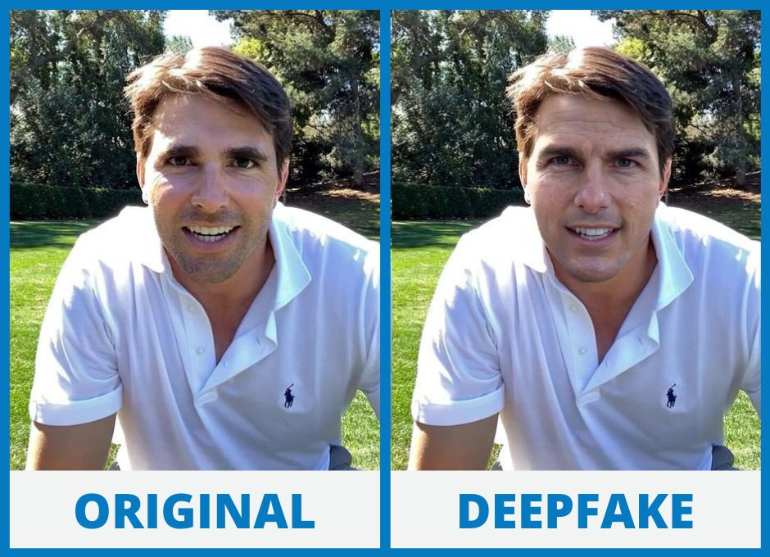
Page 03 of 15

Slide 14
GAN-Based Deepfake Detection
GAN-based Deepfake Detection Approach:
Involves training a Generative Adversarial Network (GAN) on a dataset with real and deepfake images.
GAN generates synthetic deepfake images, while a discriminator network distinguishes between real and fake samples.
Repurposing the Discriminator:
After training, the discriminator can be repurposed as a deepfake detector.
It has learned to differentiate between authentic and manipulated content.
Leveraging GAN's Realism:
Utilizes GAN's ability to create realistic forgeries to enhance the detection model's robustness against evolving deepfake techniques.
Leveraging GAN's Realism:
Utilizes GAN's ability to create realistic forgeries to enhance the detection model's robustness against evolving deepfake techniques.
Ongoing Model Adaptation:
Acknowledges that attackers may adapt over time, necessitating regular model updates and improvements.
Page 03 of 15

Slide 15
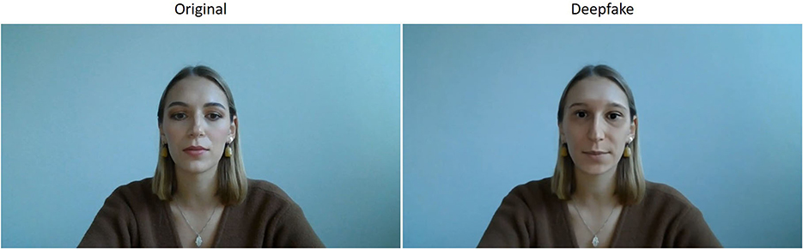
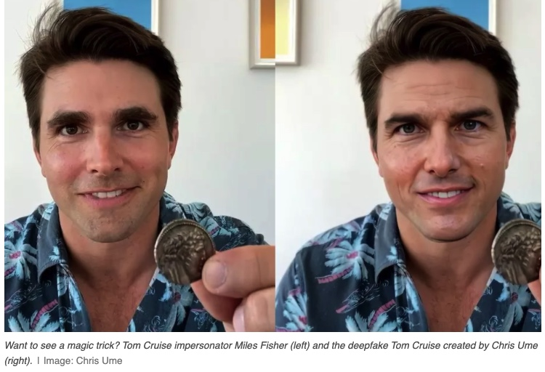
Page 03 of 15

Slide 16
Prior Work in Deepfake Detection
Title: "Capsule Forensics: Using Capsule Networks to Detect Forged Images and Videos"
Authors: Hong-Yu Zhou et al.
Summary: Proposes the use of Capsule Networks, a type of neural network architecture, for deepfake detection. This approach aims to capture hierarchical relationships within images.
Title: "Lip Sync in the Wild"
Authors: Ohad Fried et al.
Summary: Addresses the detection of deepfakes created through lip-syncing techniques. The research focuses on identifying discrepancies between lip movements and audio.
Title: "Multi-stream CNN for Detection of Adversarial Attacks"
Authors: Raghavendra Chalapathy et al.
Summary: Introduces a two-stream CNN architecture that processes both spatial and temporal information from videos. This approach aims to capture different types of deepfake artifacts.

Slide 17
Deepfake Manipulation Techniques
Face Swap:
Replacing the face of a person in an existing image or video with a different face, making it appear as though the target person is saying or doing something they didn't.
Lip Syncing:
Manipulating the lip movements of a person in a video to synchronize with an altered audio track, making it seem like they are saying something they didn't.
Facial Reenactment:
Modifying the facial expressions of a person in a video to match those of another individual, creating the illusion that the target person is mimicking the actions of someone else.
Voice Cloning:
Using AI algorithms to replicate a person's voice, enabling the creation of fake audio recordings that sound like the target person.
Face Aging/De-aging:
Altering the appearance of a person's face to make them appear older or younger than they actually are. This can be used to create fake images or videos of individuals at different ages.
Page 03 of 15

Slide 18
Entire Face Synthesis
Entire Face Synthesis:
Cutting-edge technique in deepfake technology.
Involves generating entirely new faces from scratch, not bound by any existing individual's features.
Distinct Approach:
Differs from other techniques that modify existing facial attributes.
Enables creation of wholly fictional or custom faces.
Applications:
Valuable in creative fields like computer graphics and animation.
Empowered by powerful Generative Adversarial Networks (GANs), with StyleGAN as a notable model.
GAN Operation:
Operates through a dual-network system.
Generator fabricates synthetic data, such as faces.
Discriminator discerns between real and generated content.
StyleGAN Features:
Introduces a style-based architecture.
Allows precise control over facial attributes like age, gender, and expressions.
Customization Power:
Empowers artists and creators to produce highly detailed and tailored faces for various applications.
Applications range from digital art to film special effects.
Page 03 of 15

Slide 19
Identity Swap:
Identity Swap: A pivotal technique in deepfake technology, involving seamless replacement of one person's likeness with another, creating highly convincing simulations.
Applications: Findings uses in film industry special effects and digital impersonations for entertainment, showcasing its potential across various fields.
Ethical Concerns: Raises significant ethical concerns, particularly related to the creation of non-consensual and potentially harmful content, such as celebrity pornographic films.
Privacy and Dignity: Such content infringes upon the privacy and dignity of individuals, underscoring the need for responsible use of this technology.
Misinformation and Hoaxes: Identity swap has been used to perpetrate hoaxes and spread misinformation, challenging trust and authenticity in digital media.
Industry and Regulatory Concerns: Responsible and ethical use of identity swap technology is a critical concern for both industry practitioners and regulators.
Detection Methods: Ongoing efforts to develop robust detection methods to identify and mitigate potential harms associated with identity swap.
Page 03 of 15

Slide 20
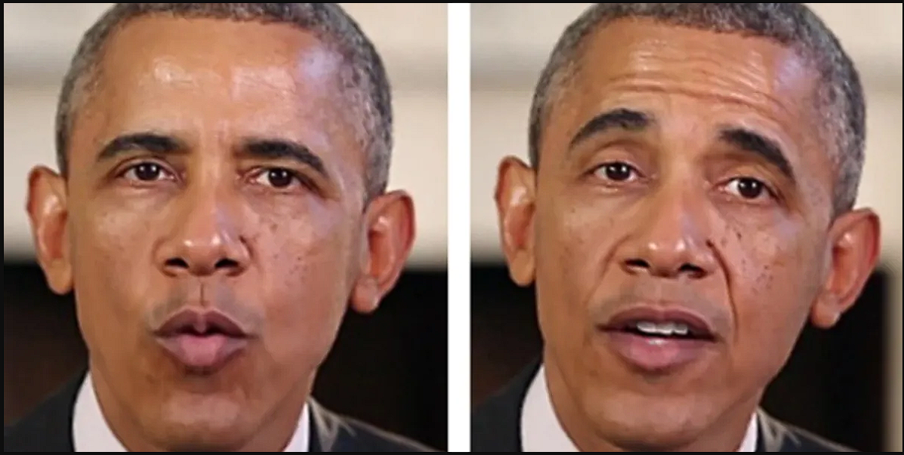
Page 03 of 15

Slide 21
Implementation using Deep Convolutional GAN
Dataset Collection and Preprocessing:
Assemble a diverse dataset containing both real and deepfake images/videos. This dataset should encompass various scenarios, lighting conditions, backgrounds, and facial expressions to ensure robust training.
Preprocess the dataset to standardize formats, resolutions, and remove any artifacts or noise that may hinder training.
Training the GAN:
Choose a suitable GAN architecture (e.g., DCGAN, StyleGAN) and define the network parameters.
Initialize the GAN with random weights and begin training. During training, the GAN learns to generate synthetic images that resemble real ones, while a discriminator network learns to distinguish between real and fake samples.
Employ techniques like adversarial loss and content loss to guide the GAN towards producing realistic-looking images.
Adversarial Training:
Iteratively train the GAN and the discriminator in a back-and-forth manner. As the GAN becomes better at generating realistic deepfake content, the discriminator becomes more discerning.
Page 03 of 15

Slide 22
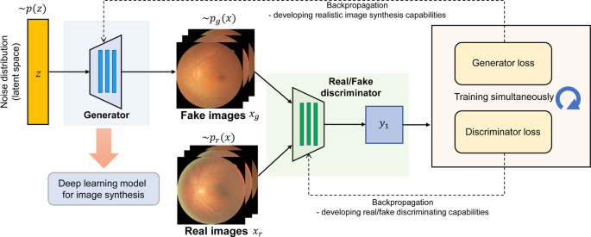
Page 03 of 15

Slide 23
Implementation using Deep Convolutional GAN
Dataset Labeling and Partitioning:
Label the dataset based on the source of the content (real or fake). This labeling is crucial for training the detection model.
Divide the dataset into training, validation, and test sets. The training set is used to train the detection model, the validation set helps fine-tune hyperparameters, and the test set assesses the model's generalization.
Detection Model Training:
Choose a deep learning model, often a Convolutional Neural Network (CNN), for detecting deepfake content.
Train the model using the labeled training data, where the input is an image or video frame, and the output is a binary classification (real or fake).
Fine-tune the model using the validation set, adjusting parameters and architectures as needed.
Performance Evaluation:
Use performance metrics such as accuracy, precision, recall, and F1-score to evaluate the detection model's effectiveness.
Conduct thorough testing on the independent test set to assess the model's generalization to new, unseen data.
Page 03 of 15

Slide 24
Implementation using Deep Convolutional GAN
Continuous Monitoring and Adaptation:
Stay updated with the latest advancements in deepfake generation techniques. Regularly reevaluate and adapt the detection system to counter evolving threats.
Ethical Considerations and Legal Compliance:
Ensure the responsible development and deployment of the technology. This includes respecting privacy rights and adhering to legal standards.
Page 03 of 15

Slide 25
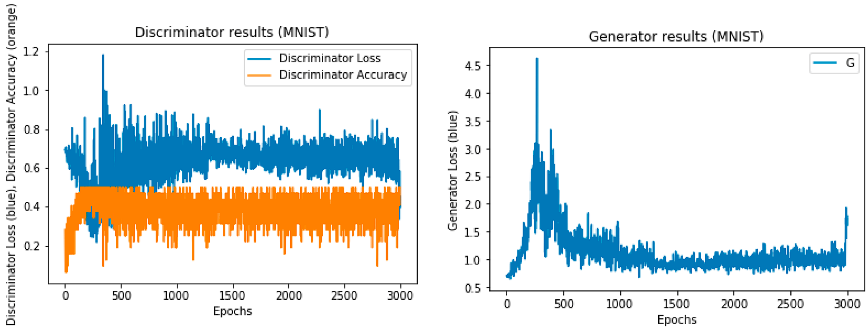
Page 03 of 15

Slide 26
Applications:
Social Media Platforms: Social media platforms can use GAN-based detectors to automatically identify and flag deepfake content, helping to curb the spread of misinformation and protect user trust.
News and Journalism: News organizations can utilize GAN-based detectors to verify the authenticity of images and videos before publishing, ensuring the dissemination of accurate information.
Forensic Analysis: Law enforcement agencies can employ GAN-based detectors to assist in criminal investigations by identifying manipulated or forged evidence.
Entertainment Industry: Film and television studios can use deepfake detection technology to prevent unauthorized use of actors' likenesses in fake scenes or videos.
Cybersecurity and Identity Verification: GAN-based detectors can be employed in cybersecurity measures to identify fraudulent or manipulated images used for identity theft or impersonation.
Page 03 of 15

Slide 27
Advantages:
Adaptability: GAN-based detectors can adapt to evolving deepfake techniques. As deepfake generation methods advance, GANs can be retrained to detect newer, more sophisticated fakes.
End-to-End Learning: GAN-based detectors learn directly from the data, which can lead to more robust and accurate detection compared to traditional handcrafted feature-based methods.
Effectiveness with Limited Data: GAN-based detectors can be effective even with limited training data. This is crucial, as deepfakes can vary widely in quality and style.
Generalization: GAN-based detectors can generalize well to different types of deepfakes, including those not seen during training. This adaptability makes them suitable for real-world applications.
Real-time Processing: Some GAN-based detectors are optimized for real-time processing, allowing for instantaneous deepfake detection in video streams.
Page 03 of 15

Slide 28
Disavantages:
Adversarial Nature: GANs are inherently adversarial, meaning that as deepfake generation techniques improve, so too must the detection methods. This creates an ongoing arms race between generators and detectors.
Resource Intensive: Training and running GAN-based detectors can be computationally expensive and time-consuming. This might limit their accessibility to smaller organizations or individuals.
Limited Interpretability: GAN-based detectors might not provide clear explanations for their decisions. This lack of interpretability can make it challenging to understand why a particular image or video was flagged as a deepfake.
Potential False Positives/Negatives: Like any machine learning model, GAN-based detectors can produce false positives (flagging authentic content as fake) and false negatives (failing to identify actual deepfakes). Achieving a balance is challenging.
Dependency on Training Data: The effectiveness of GAN-based detectors heavily depends on the quality, diversity, and relevance of the training data. Biased or inadequate training data can lead to suboptimal results.
Ethical Considerations: Using GANs for deepfake detection raises ethical concerns about privacy and consent, especially if the detection is used in public spaces or for surveillance.
In summary, GAN-based detectors offer a powerful tool for detecting deepfakes, but they come with their own set of challenges and considerations that must be carefully addressed in their development and deployment.
Page 03 of 15

Slide 29
Conclusion:
Deepfakes involve creating fake images or videos using Generative Adversarial Networks (GANs). These advanced models can convincingly swap faces or even generate entirely new ones. They pose a significant threat, impacting various sectors, including security and privacy. To detect deepfakes, researchers have explored methods like Haar wavelet transforms and biological cues. Generative models like StyleGAN have made significant strides in generating realistic facial images. The quality of generated images is assessed using metrics like Inception Score (IS) and Fréchet Inception Distance (FID). While deepfakes present challenges, ongoing research is focused on improving detection methods and mitigating their potential harms.
Page 03 of 15

Slide 30
REFERENCES:
[1] A GAN-Based Model of Deepfake Detection in Social MediaPreeti, Manoj Kumar , Hitesh Kumar Sharma.
[2] Revealing and Classification of Deepfakes Video’s Images using a Customize Convolution Neural Network Model1877-0509 © 2023 The Authors. Published by Elsevier B.V.
[3] Deepfakes as a threat to a speaker and facial recognition: An overview of tools and attack vectors
[4] Machine learning based medical image deepfake detection: A comparative study.solaiyappan@chapman.edu (S. Solaiyappan), yuwen@chapman.edu (Y. Wen)
www.reallygreatsite.com
Page 07 of 15

Slide 31
REFERENCES:
[5] DFT-MF: Enhanced deepfake detection using mouth movement and transfer learning.Journal Name (volume, issues , author):Ammar Elhassan ,Mohammad Al-Fawa'reh , Mousa Tayseer Jafar ,Mohammad Ababneh , Shifaa Tayseer Jafar
[6] Providing detection strategies to improve human detection of deepfakes: An experimental study.
[7] The realness of fakes: Primary evidence of the effect of deepfake personas on user perceptions in a design task.Journal Name (volume, issues , author):Ilkka Kaate a, Joni Salminen , Joao Santos , Soon-Gyo Jung , Rami Olkkonen , Bernard Jansen
[8] Watching the BiG artifacts: Exposing DeepFake videos via Bi-granularity artifacts.
www.reallygreatsite.com
Page 07 of 15

Slide 32

Thank You
+123-456-7890
www.reallygreatsite.com

